Slide 1
Sarcastic and Non-Sarcastic Tweet Classification Using Deep Learning Guided by: M. Dillibabu, M.E., Ph.D., Associate Professor
Benny Richards. R (211420205028)
Allen Harris. A (211420205013)
Magesh. S (211420205084)

Slide 2
Abstract
Nowadays, social media has become a popular channel for people to exchange opinions through the user-generated text.
Exploring the mechanisms about how customers' opinions towards products are influenced by friends, and further predicting their future opinions have attracted great attention from corporate administrators and researchers.
Various influence models have already been proposed for the opinion prediction problem.
However, they largely formulate opinions as derived sentiment categories or values but ignore the role of the content information. Besides, existing models only make use of the most recently received information without taking into consideration the long-term historical communication.
To keep track of user opinion behaviors and infer user opinion influence from the historical exchanged textual information, we develop a content-based sequential opinion influence framework.
Based on this framework, two opinion sentiment prediction models with alternative prediction strategies are proposed. In the experiments conducted on three Twitter datasets, the proposed models outperform other popular influence models.
An interesting finding based on a further analysis of user characteristic is that an individual's influence is correlated to her/his style of expressions.
In our project we will be using CNN+LSTM as existing and Tree Convolution Neural Network (TCNN) as proposed system.

Slide 3
Objective and scope
Increase the efficiency in predicting the hatred speech in good percentage.
Less time consumption.
User friendly and should be applicable to all datasets.
More accuracy rate.

Slide 4
Literature Survey
S.No | Title/Year | Objective | Pros | Cons
1 | Non-Fungible Tokens: What Makes Them Valuable? 2023 | Non-Fungible Tokens (NFTs) have revolutionized various industries and aspects of the digital world in several ways. Built on blockchain technology, | Good architectural work | Cannot be implemented in all datasets.
2 | Dual Sentiment Classification with Sarcasm Identification 2019 | Dual Sentiment Classification (DSC) with Sarcasm Identification | Good accuracy rate | High computational cost
3 | Twitter Sentiment Analysis for COVID-19 2021 | RoBERTa(Robustly Optimised BERT pre-training Approach) and CNN-RoBERTa Sentiment Extraction | User friendly model | Training words are difficult

Slide 5
Literature Survey
S.No | Title/Year | Objective | Pros | Cons
4 | Discriminative Deep Association Learning based on the Optimized Feature Analysis Adaptive Spider Foraging Model for twitter sentiment analysis 2023 | he tweets and messages generated from a social network with Tweet term features | Good classification | Preprocessing stage is not good
5 | Sentence Patterns based Sarcasm Detection and Classification using Long Short Term Memory Model 2022 | Long-Short Term Memory (LSTM), along with GLoVe embeddings | Good accuracy rate | High computational cost
6 | Understanding Sarcasm from Reddit texts using Supervised Algorithms 2022 | 71%, 76% and 70% accuracy for LSTM, CNN, and Logistic Regression algorithms respectively. | User friendly model | Training words is difficult

Slide 6
Literature Survey
S.No | Title/Year | Objective | Pros | Cons
7 | Shaming tweets detection on Twitter using Machine learning Algorithms 2022 | Random Forest, Naive Bayes, KNN | Good architectural work | Cannot be implemented in all datasets.
8 | BREE-HD: A Transformer-Based Model to Identify Threats on Twitter 2023 | BREE-HD performs extraordinarily well with an accuracy of 97% | Good accuracy rate | High computational cost
9 | Sarcasm Detection and Quantification in Arabic Tweets 2021 | unique in sarcasm detection and the proposed approach tackles the problem as a regression problem instead of classification; | User friendly model | Training words is difficult

Slide 7
Literature Survey
S.No | Title/Year | Objective | Pros | Cons
10 | Sarcasm detection of non # tagged statements using MLP-BP 2018 | anger, joy, contradict, humor etc but people frame the sarcasm to hide actual meaning | Good architectural work | Cannot be implemented in all datasets.

Slide 8
Existing system-CNN
Convolution Neural Network:
In deep learning, a convolutional neural network (CNN, or ConvNet) is a class of deep neural networks, most commonly applied to analyzing visual imagery.
They are also known as shift invariant or space invariant artificial neural networks (SIANN), based on their shared-weights architecture and translation invariance characteristics.
CNNs are regularized versions of multilayer perceptrons.
Multilayer perceptrons usually mean fully connected networks, that is, each neuron in one layer is connected to all neurons in the next layer.
The "fully-connectedness" of these networks makes them prone to overfitting data. Typical ways of regularization include adding some form of magnitude measurement of weights to the loss function.
CNNs take a different approach towards regularization: they take advantage of the hierarchical pattern in data and assemble more complex patterns using smaller and simpler patterns.
Therefore, on the scale of connectedness and complexity, CNNs are on the lower extreme.

Slide 9
Existing system-LSTM
Long Short Term Memory (LSTM):
Long short-term memory (LSTM) is an artificial recurrent neural network (RNN) architecture used in the field of deep learning.
Unlike standard feed forward neural networks, LSTM has feedback connections. It can not only process single data points (such as images), but also entire sequences of data (such as speech or video). For example, LSTM is applicable to tasks such as unsegmented, connected handwriting recognition, speech recognition and anomaly detection in network traffic or IDSs (intrusion detection systems).
A common LSTM unit is composed of a cell, an input gate, an output gate and a forget gate.
The cell remembers values over arbitrary time intervals and the three gates regulate the flow of information into and out of the cell.
LSTM networks are well-suited to classifying, processing and making predictions based on time series data

Slide 10
Existing system Disadvantages
The current work only considers the influence from neighbors. So, to extend capture the influence of the external information sources on users opinion behaviors.
Sentence extraction difficult to find the optimal opinions.
Redundancy occur is more.
Finding opinion target extraction and opinion summarization is very hard.

Slide 11
Proposed system
Tree Convolution Neural Network (Tree CNN):
A Convolution Neural Network (CNN) is a class of artificial neural networks where connections between nodes form a graph along a temporal sequence.
This allows it to exhibit temporal dynamic behavior. Derived from feed forward neural networks, CNNs can use their internal state (memory) to process variable length sequences of inputs.
This makes them applicable to tasks such as unsegmented, connected handwriting recognition or speech recognition.
The term “Enhanced neural network” is used indiscriminately to refer to two broad classes of networks with a similar general structure, where one is finite impulse and the other is infinite impulse. Both classes of networks exhibit temporal dynamic behavior.
A finite impulse recurrent network is a directed acyclic graph that can be unrolled and replaced with a strictly feed forward neural network, while an infinite impulse recurrent network is a directed cyclic graph that cannot be unrolled.

Slide 12
Proposed system Working
In propose a novel cross-domain sentiment classification algorithm and content based sentiment analysis algorithm based on term frequency, to analyze the sentiment polarity for short texts.
It expand feature vectors based on unlabeled data from the target domain.
In this way, some important sentiment indicators for the target domain are appended to feature vectors.
At last, validation of algorithm on one target dataset by using two typical datasets.
The project, mainly focus on positive and negative sentiment reviews. The first strategy is to identify the reviews as positive or negative by using the positive and negative words used in the review comments.
Then expand features based on the co- occurrence frequency between a candidate of additional related feature and a domain-independent feature.
Compared with point wise mutual information, sentiment related index considers the distributions of word occurrences instead of the co- occurrence frequency between different words, thus surmounting the challenge caused by infrequent features and words.
Then calculate weightage and ranking in each opinions using content analysis algorithm.

Slide 13
Proposed system advantages
Sentence extraction is not difficult to find the optimal opinions.
Redundancy occur is less.
Finding target extraction and opinion summarization is very easy.

Slide 14
Novelity
The proposed algorithm, Tree CNN is new and not implemented before.
It has an accuracy rate of more than 85% - 90%.
Its processing and classifying time is faster than other algorithms.

Slide 15
Hardware used
Processor: I3 Processor.
Ram: 8 GB
Hard Disk: 500 G.B Hard Disk
14 inch monitor

Slide 16
Software used
Operating System: Windows 7/8/10
Technology: Deep Learning
Languages used: Python

Slide 17

Architecture Diagram
Input Dataset
Pre-Processing
Feature Extraction and Execution
Output Prediction
Classification

Slide 18
Modules description
A. Instagram/Twitter API
User needs to register first by giving his/her own information. While registering user should give their exact current location. If he/she is giving wrong location means, he is not supposed to register and login. And that user will be considered as a blocked user.
So user needs to give only the current location. After registration user will login with username and password.
Then he/she can see their profile and can view all user tweets. Admin needs to login with username and password. If both match, he/she will be considered as a valid person. After login, admin can view all blocked user who gave wrong location while registration. Admin can able to see all users profile and tweets.
B. Post contents
In this module registered user can post tweets in insta.
If the user tries to post any tweet which contains bad words means, it will not get posted in the instagram account. So the algorithm will restrict the user not to post bad words.
The general posts can be posted in application and as well as in insta.

Slide 19
Modules description
C. Search Query
Here in this module, user can search for any query in the application. The query has been processed and extracted live tweets from the real time twitter. The Keywords related 100 tweets are extracted from the live twitter.
D. Preprocessing
In this step all the tweets are extracted from twitter are processed and the noise data are removed.
1) Stop words Removal: A dictionary based approach is been utilized to remove stop words from tweets. A generic stop word list containing 75 stop words created using hybrid approach is used. The algorithm is implemented as below given steps. The target text is tokenized and individual words are stored in array.
A single stop word is read from stop word list. The stop word is compared to target text in form of array using sequential search technique. If it matches, the word in array is removed, and the comparison is continued till length of array. After removal of stop word completely, another stop word is read from stop word list and again algorithm runs continuously until all the stop words are compared.
Resultant text devoid of stop words is displayed, also required statistics like stop word removed, no. of stop words removed from target text, total count of words in target text, count of words in resultant text, individual stop word count found in target text is displayed.

Slide 20
Modules description
2) Stemming Technique: After removing the unwanted words from the tweet, stemming technique is processed. Stemming is the process of reducing inflected (or sometimes derived) words to their word stem, base or root form generally a written word form. The stem need not be identical to the morphological root of the word; it is usually sufficient that related words map to the same stem, even if this stem is not in itself a valid root.
E. Classification
After stemming process, all the tweet terms containing the keyword are classified into positive, negative and neutral tweets. CNN, LSTM, TCNN is used for classification. Here we are having good words and bad words datasets. By comparing with this, we can classify the posts into positive, negative and neutral tweets.

Slide 21
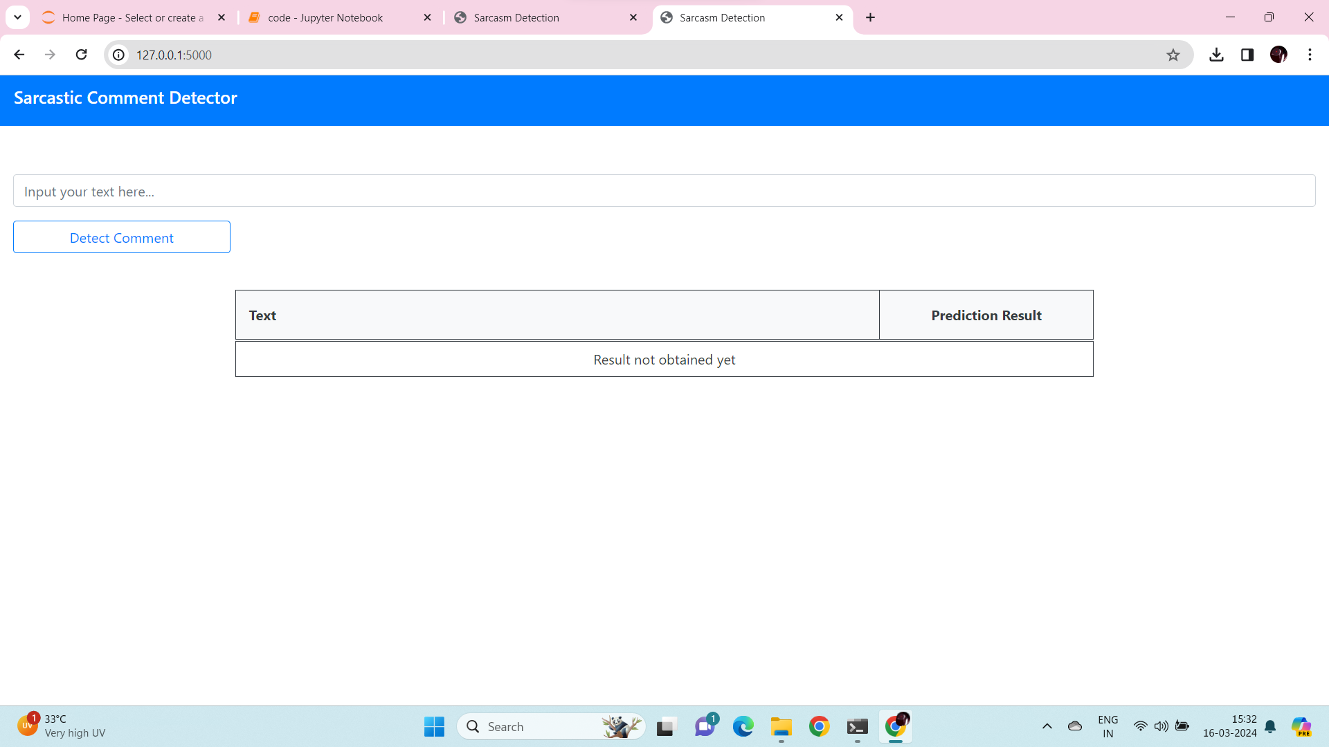
Project Results

Slide 22
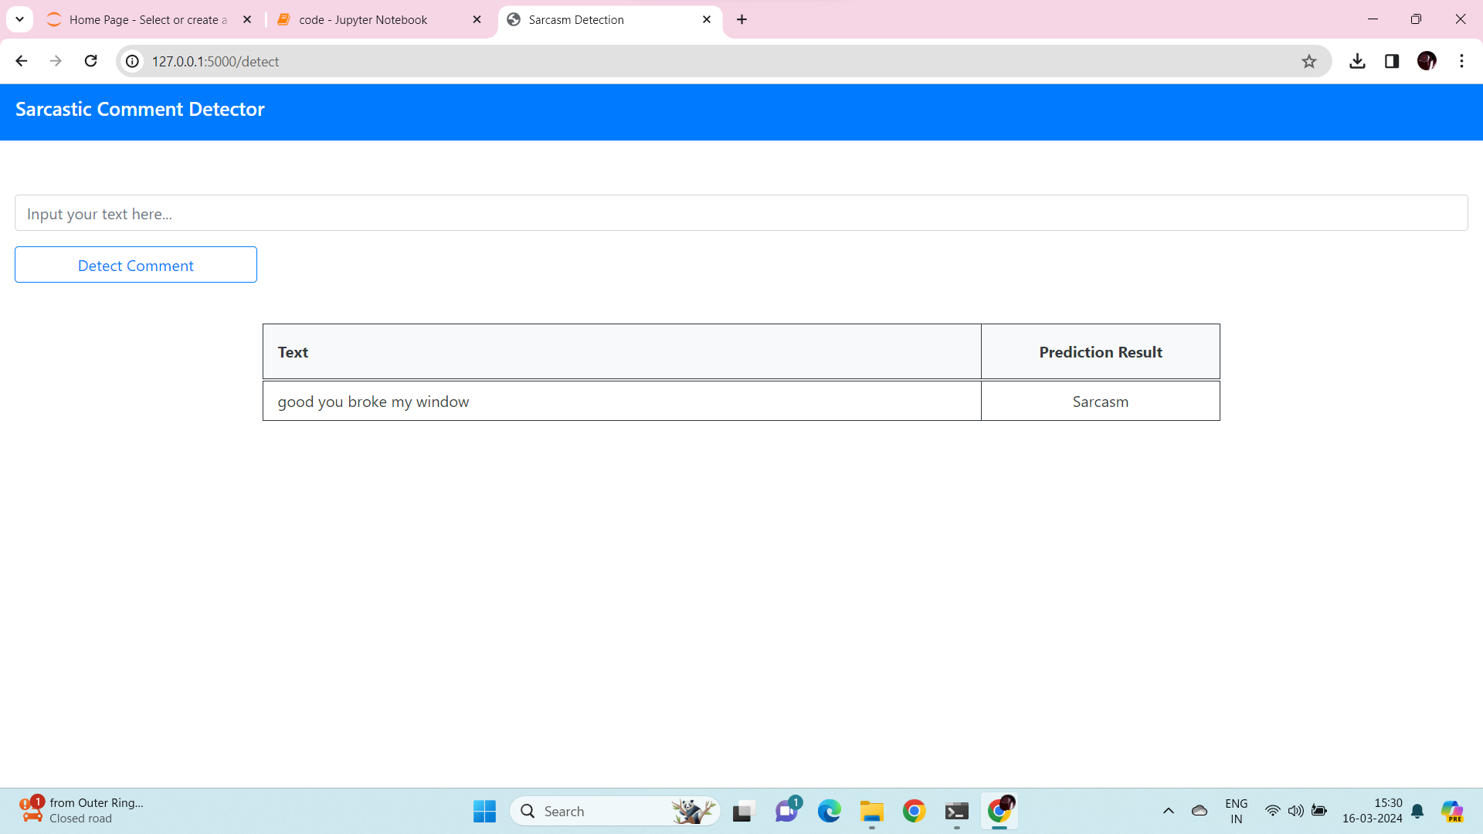

Slide 23


Slide 24
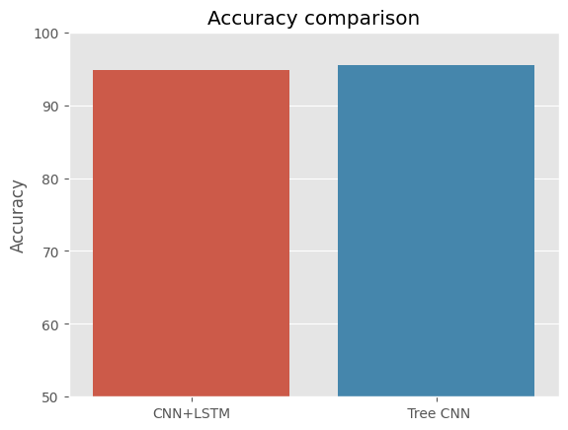
Performance Measures of Proposed System

Slide 25
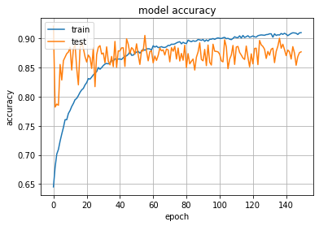
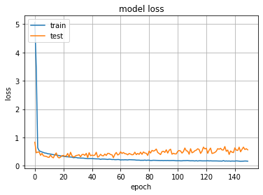
Model’s Accuracy and Loss on Test and Train Data

Slide 26
Conclusion
The experiments conducted on the Twitter dataset demonstrate the effectiveness of the two proposed models.
The prediction ability of the proposed model is further verified on the opinion word prediction task.
Based on the learned influence, we explore the expression styles of users with different influence powers, which provide the valuable information for people to manage their accounts and design marketing plans.

Slide 27
References
[1] Daniele Cenni, Paolo Nesi, Gianni Pantaleo, Imad Zaza., “Twitter vigilance: A multi-user platform for cross-domain Twitter data analytics, NLP and sentiment analysis”, In Proceedings of the IEEE International Conference.
[2] Oussalah M, Bhat F, Challis K, Schnier T. A software architecture for Twitter collection, search and geolocation services, In Knowledge-Based Systems. Vol. 37, pp.105-120, 2013.
[3] Alexandre Trilla, Francesc Alias, "Sentence- Based Sentiment Analysis For Expressive Text-To-Speech, IEEE Transactions on Audio, Speech, and Language Processing (Volume: 21 , Issue: 2 , Feb. 2013 ).
[4] Shulong Tan, Yang Li, Huan Sun, Ziyu Guan, Xifeng Yan, Jiajun Bu, Chun Chen Xiaofei He, "Interpreting The Public Sentiment Variations On Twitter", IEEE Transactions on Knowledge and Data Engineering ( Volume: 26 , Issue: 5 , May 2014 ).
[5] Desheng Dash Wu, Lijuan Zheng, David L. Olson, “A Decision Support Approach For Online Stock Forum Sentiment Analysis”, IEEE Transactions on Systems, Man, and Cybernetics: Systems (Volume: 44, Issue: 8 , Aug. 2014 ).

Slide 28
References
[6] Ruhi U., Social Media Analytics as a Business Intelligence Practice: Current Landscape & Future Prospects, In Journal of Internet Social Networking & Virtual Communities, 2014.
[7] Shokoufeh Salem Minab, Mehrdad Jalali, Mohammad Hossein Moattar, “Online Analysis Of Sentiment On Twitter”, 2015 International Congress on Technology, Communication and Knowledge (ICTCK).
[8] Lavika Goel, Anurag Prakash, “Sentiment Analysis of Online Communities Using Swarm Intelligence Algorithms”, 2016 8th International Conference on Computational Intelligence and Communication Networks (CICN).
[9] Lu Ma, Dan Zhang, Jian-wu Yang, Xiong Luo., “Sentiment Orientation Analysis Of Short Text Based On Background And Domain Sentiment Lexicon Expansion”, 2016 5th International Conference on Computer Science and Network Technology (ICCSNT).
[10] H. Sankar, V. Subramaniyaswamy, "Investigating Sentiment Analysis Using Deep Learning Approach", International Conference on Intelligent Sustainable Systems (ICISS) (2017).

Slide 29
References
[11] K. Young, M. Pistner, J. O’Mara, and J. Buchanan. Cyber-disorders: The mental health concern for the new millennium. Cyberpsychol. Behav., 2019..
[12] J. Block. Issues of DSM-V: internet addiction. American Journal of Psychiatry, 2019.
[13] K. Young. Internet addiction: the emergence of a new clinical disorder, Cyberpsychol. Behav., 2019.
[14] I.-H. Lin, C.-H. Ko, Y.-P. Chang, T.-L. Liu, P.-W. Wang, H.-C. Lin, M.-F. Huang, Y.-C. Yeh, W.-J. Chou, and C.-F. Yen. The associa- tion between suicidality and Internet addiction and activities in Taiwanese adolescents. Compr. Psychiat., 2019.
[15] Y. Baek, Y. Bae, and H. Jang. Social and parasocial relationships on social network sites and their differential relationships with users’ psychological well-being. Cyberpsychol. Behav. Soc. Netw., 2019.

Slide 30
References
[16] D. La Barbera, F. La Paglia, and R. Valsavoia. Social network and addiction. Cyberpsychol. Behav., 2019.
[17] K. Chak and L. Leung. Shyness and locus of control as predictors of internet addiction and internet use. Cyberpsychol. Behav., 2019.
[18] K. Caballero and R. Akella. Dynamically modeling patients health state from electronic medical records: a time series approach. KDD, 2019.
[19] L. Zhao and J. Ye and F. Chen and C.-T. Lu and N. Ramakr- ishnan. Hierarchical Incomplete multi-source feature learning for Spatiotemporal Event Forecasting. KDD, 2019.
[20] E. Baumer, P. Adams, V. Khovanskaya, T. Liao, M. Smith, V. Sosik, and K. Williams. Limiting, leaving, and (re)lapsing: an exploration of Facebook non-use practices and experiences. CHI, 2019.

